Slide 1


Architectural Design
Identifying and putting together the components of your game
Part 1- Principles

Slide 2

Key Components
(in 2D Games)

Slide 3
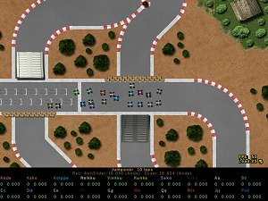

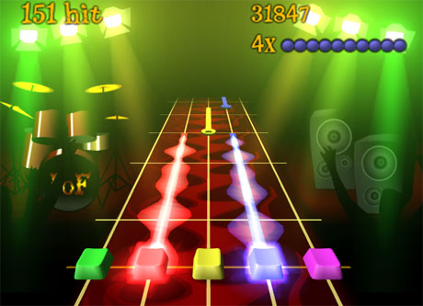
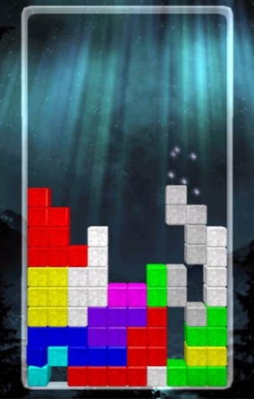
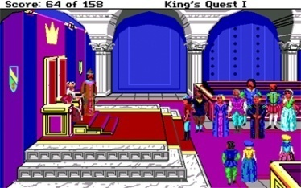
Racing game
Easy:
Distilling Key Components/Actions
Select a game genre (assuming a 2D game).
Think about games in this genre; how do they look; what features do they have; what things do they do.
Try to identify common aspects that most games in the genre will share in terms of features and behaviour.
Platform game
Rhythm game
Hard:
Adventure game
Start
10 mins
9 mins
8 mins
7 mins
6 mins
5 mins
4 mins
3 mins
2 mins
1 min
30 sec
Finished
Puzzle game

Slide 4

Things most 2D game have...
Front-end (titles, menus)
Assets
Graphical assets (animations, png’s)
Sound assets (sfx, music)
Objects
In-game objects (sprites, platforms)
HUD objects (score, lives)
Object Containers
Levels, Areas, Maps
Input Events
Things most 2D game do...
Once per game/per level
Load assets
Construct objects
Populate containers
Lots of times each second
Consider input events
Update objects
Draw graphics
Consider sounds
Note: There is no correct answer. Each model will impose a certain set of assumptions, suiting some types of game but not others.

Slide 5
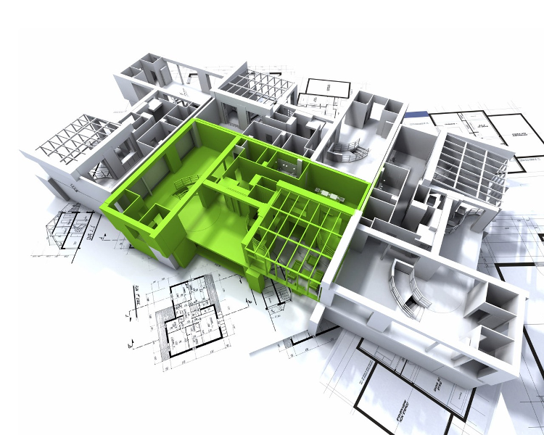

Game Architecture
(In the Abstract)

Slide 6

: Object-Oriented Design
Abstraction and Encapsulation
What properties define the game object?
What functionality is offered by the game object?
Which assets are needed (images, sounds).
How is the object updated.
How is the object drawn.
Where does this object live (which collection).
Is this object part of an inheritance hierarchy.
Which other objects will need to communicate with this object?
Inheritance and Composition
How does the game object relate to other game objects?

Slide 7
: High-Level Groupings
Game objects have:
Defined type
Properties
Functionality
File System
The collective property set of all game objects defines the game state at an instance in time
Object
Input Devices
Object
Object
Graphics Devices
Object
Sound Devices
Game objects can interact with one another
Game objects can be grouped together

Slide 8
: Game Loop Linkage
Input events may be ‘consumed’ by the main game loop, layers and/or objects
Input Events
Game Engine
construct {
Load assets()
Build containers()
}
Game Layer
construct {
Build objects()
}
update {
Update objects()
}
draw {
Draw objects()
}
object
object
Game contains objects (player, collectables, score, etc.).
run {
loop {
Update active layers()
Draw visible layers()
}
}
object
Assets are loaded at runtime and should be managed via an asset manager
Asset Manager

Slide 9
: Collections
Game Layer
Objects within a game layer are often combined together into related groups.
The best way to group the objects depends upon the number of objects, the frequency with which objects are added or removed and the frequency at which objects are accessed.
Array / Dynamically Sized Array
obj
obj
obj
obj
obj
obj
Hash Map
obj
Linked List
obj
obj
obj
obj
Aside: You will learn more about the ‘internal’ workings of the collection classes in the Data Structures and Algorithms module.

Slide 10
: Devolved vs. Centralised Control
Centralised Control
One central process (e.g. defined within a layer) updates a number of game objects
Update Process
Easy to coordinate behaviour between multiple objects
Can be cumbersome to manage if objects differ in their update behaviour
Object
Object
Decentralised Control
Each game object updates itself
Object
Easy to isolate object specific updating
Can be difficult to manage inter-object interaction
Update Process
Object
Update Process
Or both! – The options are not mutually exclusive and can be combined (common update followed by devolved per-object update).

Slide 11
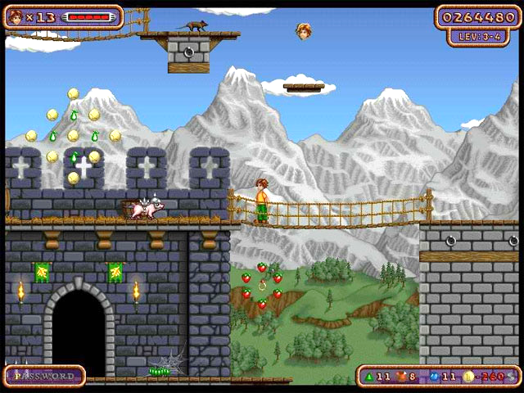
: Doing Things in the Right Order
Ordered Drawing
In 2D games it is important to draw game objects in the right depth order (background vs. foreground objects).
Ordered Updating
It is normally useful to update game objects in a certain order (e.g. first check for collisions, then resolve collisions, then update score, etc.)
Player drawn in front of background and castle wall, but behind rope bridge.
Castle wall drawn in front of background scenery
Hud drawn on top of everything

Slide 12

Key takeaways:
Identify the objects (interactive, informative, decorative) in your game
Ask: What properties does the object have? What does it do (update)? How is it drawn (render)?
Ask: Are objects related? How are objects grouped?

